Slide 1



Insurance Policy Management Application
CLAIMSAIL
SIMPLIFYING INSURANCE, ONE CLICK AT A TIME
2023
GROUP 3

Slide 2
Index
01
02
03
04
Project Scope
Tech Stack
Schema
Functionalities
A COMPREHENSIVE OVERVIEW OF THE APPLICATION'S USE CASE
DESCRIBES EVERYTHING THAT WENT INTO BUILDING THE APPLICATION
AN OVERVIEW OF THE DATABASE'S TABLE STRUCTURE AND THE RELATIONSHIPS BETWEEN THE TABLES
SHOWCASES THE EXTENSIVE CAPABILITIES AND RICH ARRAY OF FUNCTIONALITIES THAT THE APPLICATION OFFERS

Slide 3
Index
05
06
07
08
Output
Time Line
Team
Conclusion
AN OVERVIEW OF THE COMPLETED APPLICATION AND ITS FEATURES
OVERVIEW OF THE ITERATIVE DAILY SPRINTS AND THE COLLABORATIVE TEAM ACTIVITIES DILIGENTLY UNDERTAKEN THROUGHOUT THE ENTIRE PROJECT DEVELOPMENT LIFECYCLE
GET TO KNOW THE TEAM BEHIND THE APPLICATION
OUR INSIGTHS ON EVERYTHING WE LEARNT DURING THE THE PROJECT DEVELOPMENT LIFECYLCE

Slide 4
Another idea, equally important
Scope
PROBLEM
Inefficient manual insurance processes and lack of user-friendly platforms hinder effective policy management and customer engagement.
CHALLENGES
Complex policy handling, inadequate customer engagement, and time-consuming administrative tasks pose obstacles in the insurance sector.
SOLUTION
Our application streamlines policy management, enhances user engagement, and automates processes, addressing industry challenges and providing an intuitive platform for insurance companies and policyholders.

Slide 5
Introduction
Comprehensive Insurance Management: The Full stack Insurance Policy Management Application efficiently tracks and organizes insurance policy, customer, and company details, serving as an indispensable tool for insurance companies of all types.
Enhanced Customer Experience: By offering online accessibility, the system streamlines insurance processes, including policy sanctioning and policy detail processing, elevating customer experience and engagement.
Intuitive User Interface: Upon entering the platform, users are presented with insightful information about insurance types, policies, and diverse duration schemes, providing clarity and guidance for effective decision-making.
Effortless Online Interaction: The process of applying for insurance policies online is made simple and easy, making it a user-friendly and convenient experience for prospective policyholders.
Empowering Policyholders: This system empowers policyholders by enabling them to view their own insurance status information. Additionally, policyholders can access policy details securely through a personalized login. Furthermore, users benefit from prompt query resolution, as the system facilitates quick and efficient responses to their inquiries.

Slide 6
TechStack
MySQL
Database
JAVA
Programming Language
Spring Boot
Server Side
Angular
Front end
Tomcat
Server

Slide 7
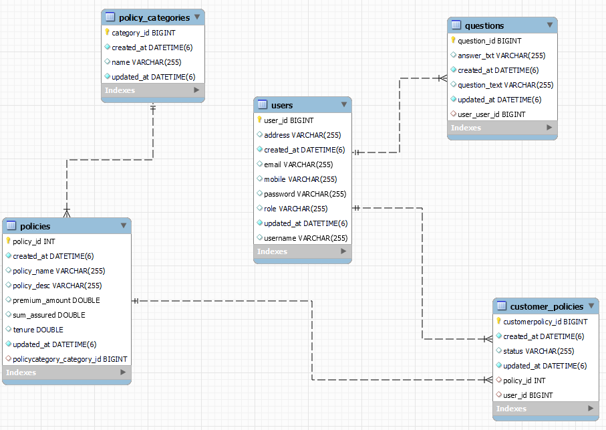
Schema
E-R Diagram of the Insurance Management application.

Slide 8
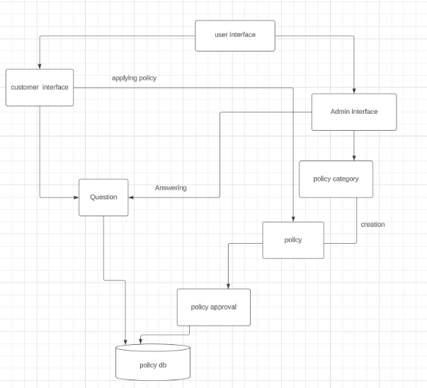
Data-Flow-Diagram

Slide 9
Admin Functionalities
Login to the Application
Create Admin Account
View/ Update/ Delete - Customer, Policy, Policy category,
View total policy holder, approved policy holder, disapproved policy holder
Approve/ Reject policies applied by customers
Answer customer questions
Update Profile information.

Slide 10
User Functionalities
Login/ Register to the Application
Update Profile information
View all policies that are added by admin
Apply to policies
Check policy status
View applied policies
Ask a question
Check Question History

Slide 11
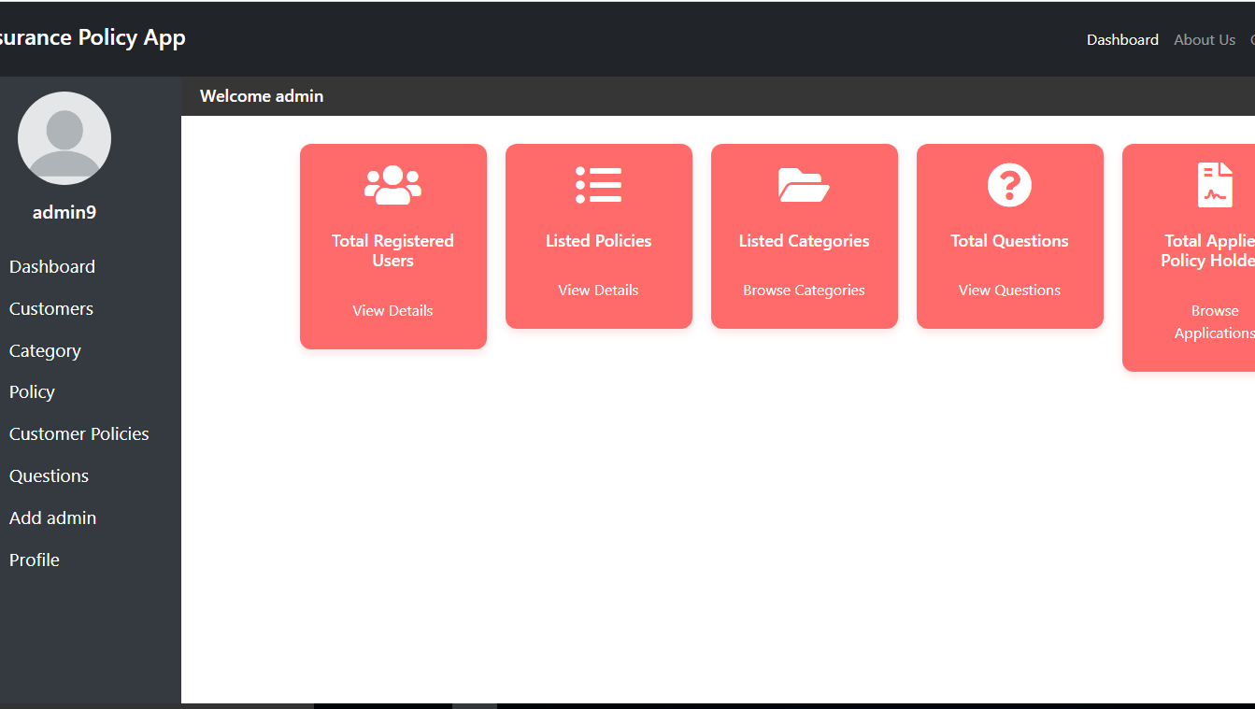
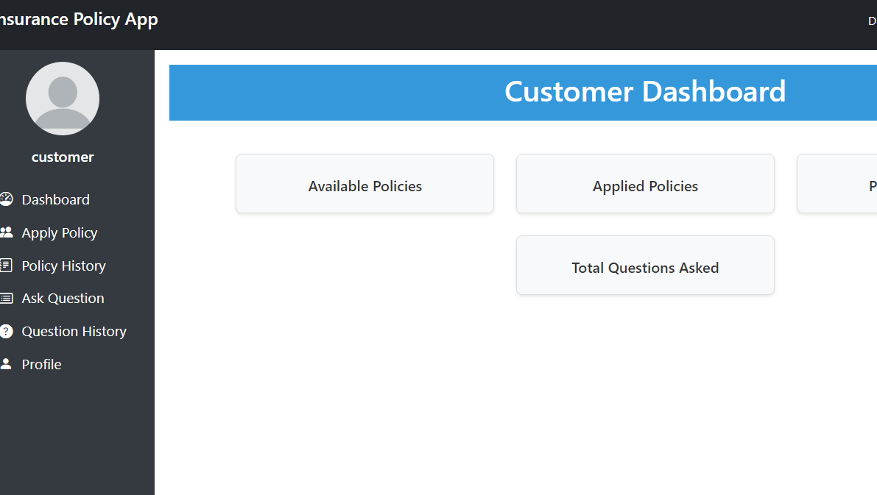
Output
Admin Dashboard
Customer Dashboard
We shall now demonstrate the Application

Slide 12
Project plan
Project Development Lifecycle:
Project Completion
Testing
Front end Programming
Testing
Back end Programming
Finalise schema
Version Setup
Schema Design
14-AUG-2023
12-AUG-2023
11-AUG-2023
10-AUG-2023
9-AUG-2023
8-AUG-2023
7-AUG-2023

Slide 13


THE TEAM
MUTHUPRIYA MURUGESAN
NAVYA K K
SHALINI KOTHANDARAMAN
NIKITA DHANANJAY GAIKWAD
SANDESH A RAM
TUSHAR RANJAN NAYAK
PONUGOTI SIREESHA REDDY
BRINDHAA BALASUBRAMANIAM

Slide 14
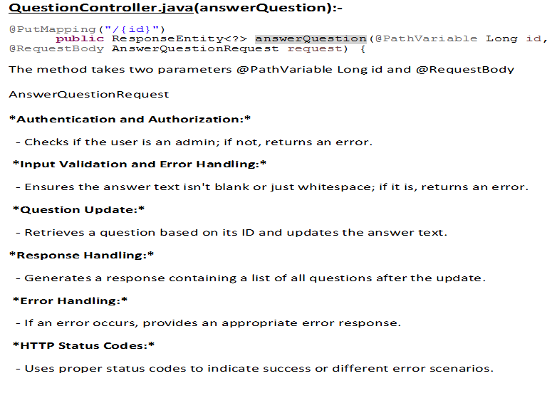
Sireesha

Slide 15
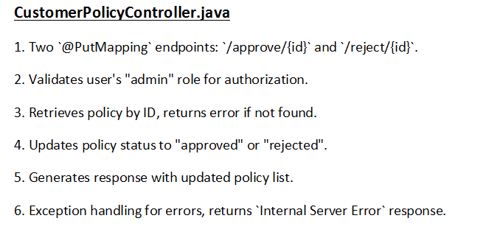

Slide 16
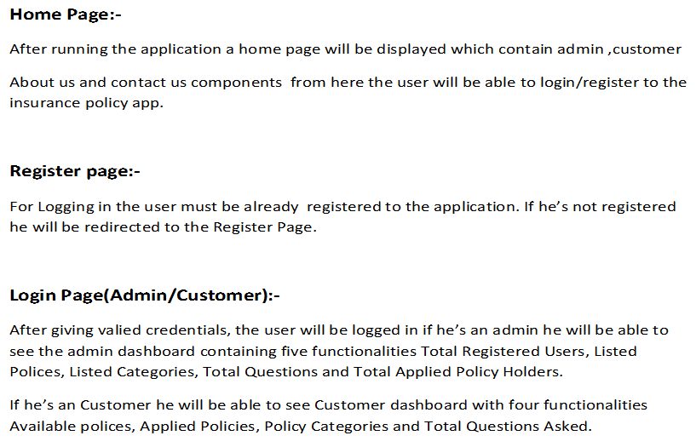

Slide 17
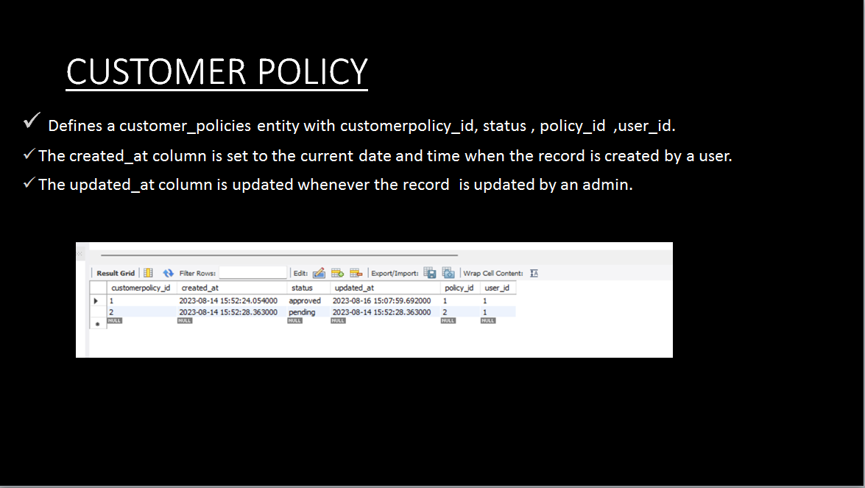
CUSTOMER POLICY
Brindhaa

Slide 18
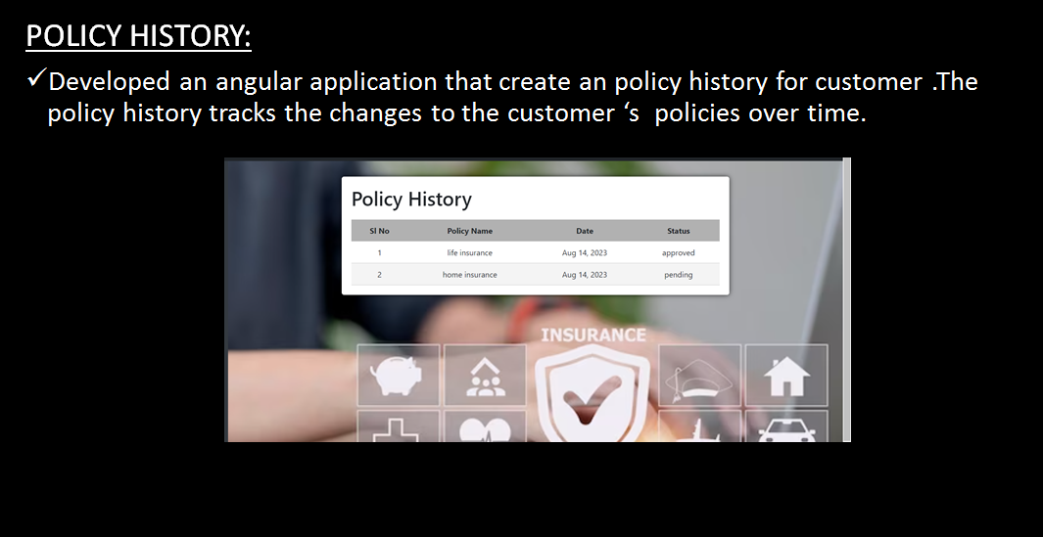
POLICY HISTORY:
Developed an angular application that create an policy history for customer .The policy history tracks the changes to the customer ‘s policies over time.

Slide 19
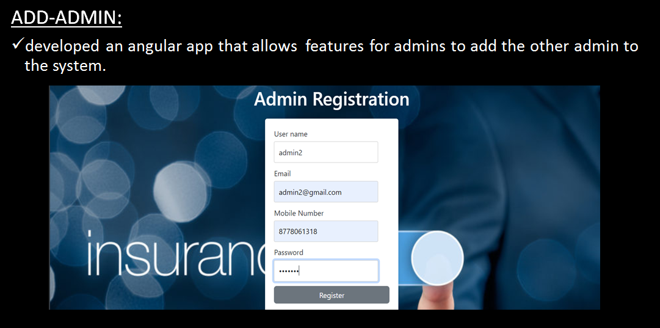

Slide 20
Muthupriya
Backend
QuestionContoller.java
Endpoints and Functionality:
The controller offers various endpoints to perform actions related to questions:
Authentication and Authorization:
Role-based access control is enforced:
Response Handling:
Successful responses are structured using the QuestionResponse class
Exception Handling:
The controller employs try-catch blocks to handle exceptions that may arise during the execution of methods.
Request and Response Formats:
Requests and responses are exchanged in JSON format, adhering to the REST architectural style.
Data Validation:
Input data validation is performed
Integration with Services:
The controller collaborates with the QuestionService and CustomUserDetailsService
HTTP Status Codes:
HTTP status codes are used to indicate the outcome of the operations
Access Control and Security:
Access control based on user roles

Slide 21
QuestionServices.java
Service Layer
Acts as an intermediary between the controller and repository.
Annotations:
@Service: Marks the class as a Spring service component.
Autowired Dependencies:
QuestionRepo injected for database interaction.
Methods and Functionality:
getAllQuestions():
getMyQuestions(User user):
getQuestionById(Long id):
createQuestion(Question question):
updateQuestion(Question updatedQuestion):
deleteQuestion(Long id)
Data Retrieval and Manipulation:
Utilizes the QuestionRepo for database operations.

Slide 22
Model/Question.java
Annotations:
@Entity
@Table(name = “questions”)
Attributes:
questionId
user
questionText
answerText
createdAt
updatedAt
Constructor:
Provides both parameterized and default constructors.
Accessors (Getters and Setters):
Facilitates data retrieval and updates.

Slide 23
Frontend
ContactUs - Social Media,Phone Support
AboutUs - About Insurance Management System

Slide 24
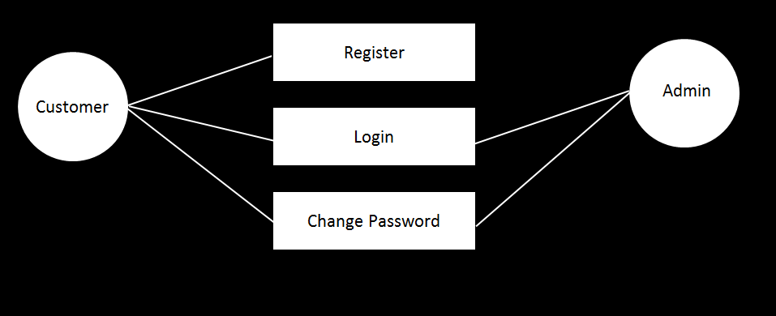
Tushar

Slide 25
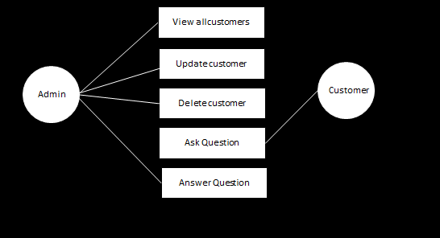

Slide 26
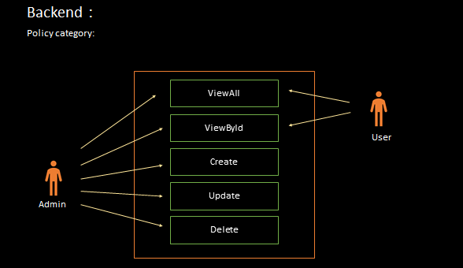
Nikita

Slide 27
package com.insurance.policy.models;
Model package provides a structured and organized way to define and manage the data entities and their attributes.
package com.insurance.policyapp.repositories;
This class defines a spring data JPA repository interface name policy category.
Provides basic CRUD operation.
package com.insurance.policyapp.services;
Created a service class that provides method to manage policy categories(view, create, delete, update) in the insurance policy application.
package com.insurance.policyapp.controllers;
ViewAllCategories: / ---(GET (This will return all the categories)
AddCategory: / ---(POST(This will create a new category, ONLY FOR ADMIN USERS)
UpdateCategory: /id ---(PUT(this will update a category, id is the category id that needs to be updated, ONLY FOR ADMIN USERS)
DeleteCategory: /id ---(DELETE(this will delete a category, id is the category id that needs to be deleted, ONLY FOR ADMIN USERS)

Slide 28
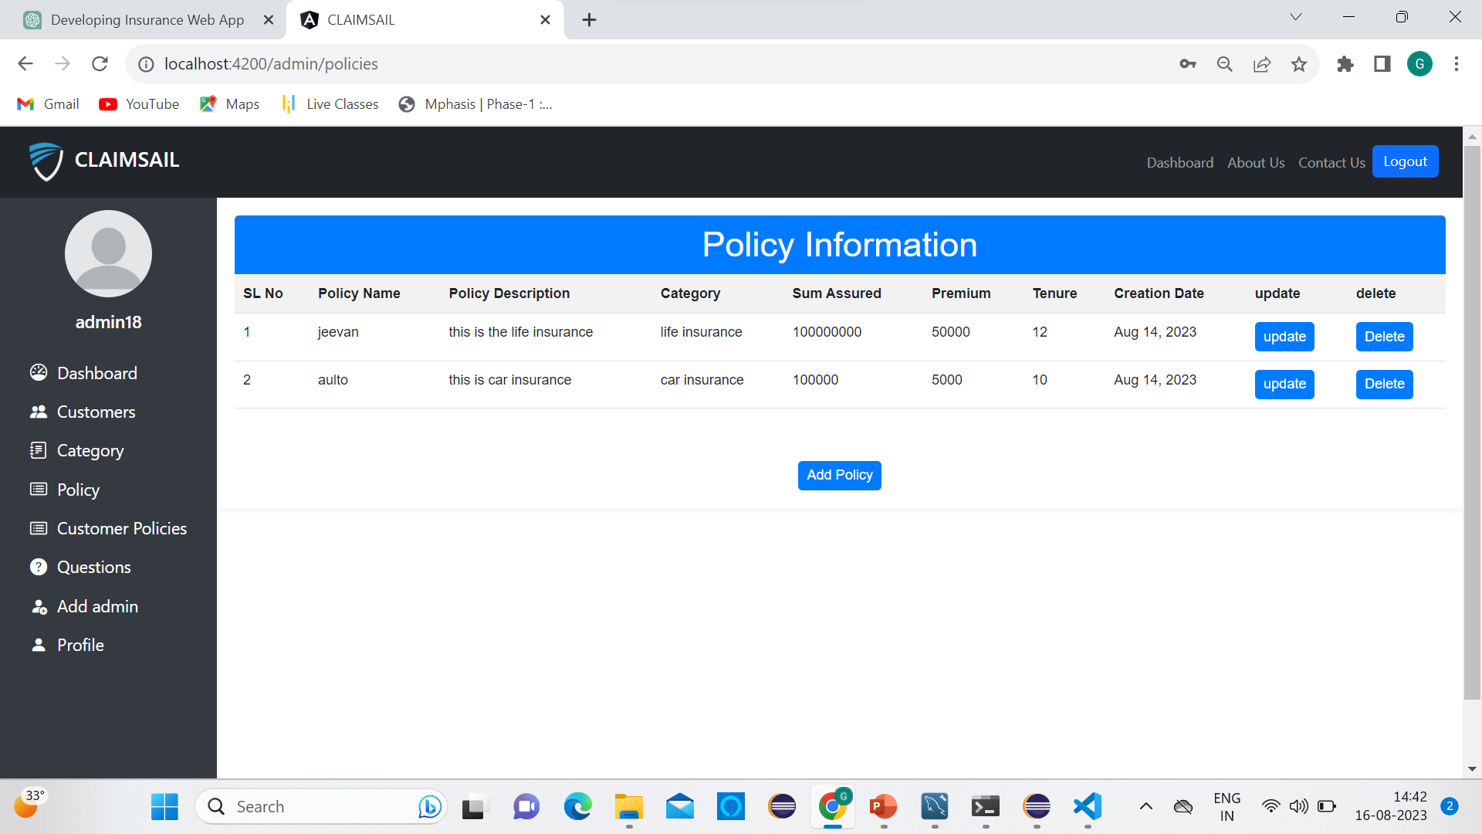
Frontend
Policies

Slide 29
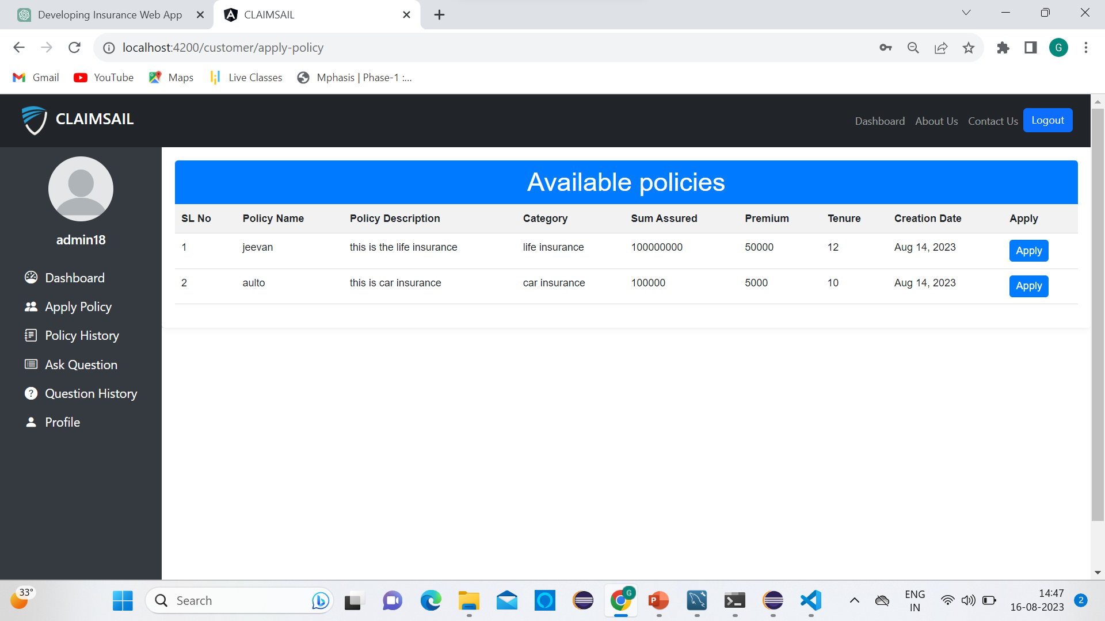
Apply - Policy

Slide 30
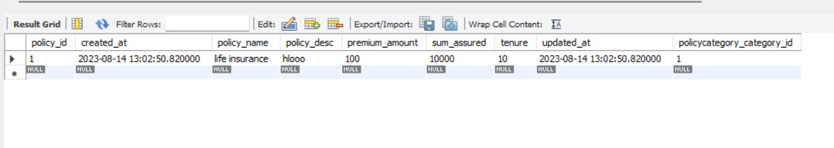
Shalini
BACK-END:
Policy Module:
Policy.java:
This is a model class representing an insurance policy. It's annotated with JPA annotations for database mapping. The class contains fields such as policyId, policyName, policycategory, policydesc, premiumAmount, tenure, sumAssured, createdAt, and updatedAt. The annotations help map these fields to the corresponding database columns.

Slide 31
PolicyService.java:
This service class handles business logic related to policies. It interacts with the PolicyRepository to perform CRUD operations on policies. It has methods to find policies by category, find by ID, fetch all policies, save a policy, update a policy, and delete a policy.
PolicyController.java:
This is the REST controller class that exposes endpoints to manage policies. It uses the PolicyService to perform actions like adding, updating, viewing, and deleting policies.
PolicyRepository.java:
This interface extends the JpaRepository interface and defines methods for querying policies from the database. It includes methods like finding policies by policy name, policy category, and policy description.

Slide 32
FRONT-END:
Cusomer-register:
customer-register.component.html:
This HTML template defines the UI elements for the user registration form.
The form includes input fields for username, email, mobile number, and password.
The "Register" button is disabled if the form is invalid.
customer-register.component.css:
This CSS file styles the appearance of the registration form.
It uses CSS selectors to define the appearance of different elements within the form.
It sets up a background image for the registration form using background-image.

Slide 33
customer-register.component.ts:
This TypeScript component handles the logic of the user registration form.
The RegisterUser class (likely a data model) is imported to represent the user's registration data.
In the onSubmit method, a password validation regular expression (passwordRegex) is defined to ensure that the password meets certain criteria (at least one lowercase, one uppercase, one digit, and one special character).
If the password is valid, the customerRegister method from the UserService is called.
user.service.ts:
This service is responsible for handling user-related operations, such as registration, login, and profile updates.

Slide 34
view-customers.component.ts:
This TypeScript component is responsible for displaying a list of customers, allowing an admin user to edit and delete customer profiles.
getAllCustomers(): This function uses the AdminService to fetch all customers from the backend and updates the customers array.
updateCustomer(): This function is called when the admin updates a customer's details. It sends an update request to the backend using the AdminService, then updates the customers array with the updated data.
deleteCustomer(customerId: number): This function is used to delete a customer. It sends a delete request to the backend using the AdminService. If the customer has applied to a policy, it shows an error message.

Slide 35
admin-dashboard.component.html and css:

Slide 36
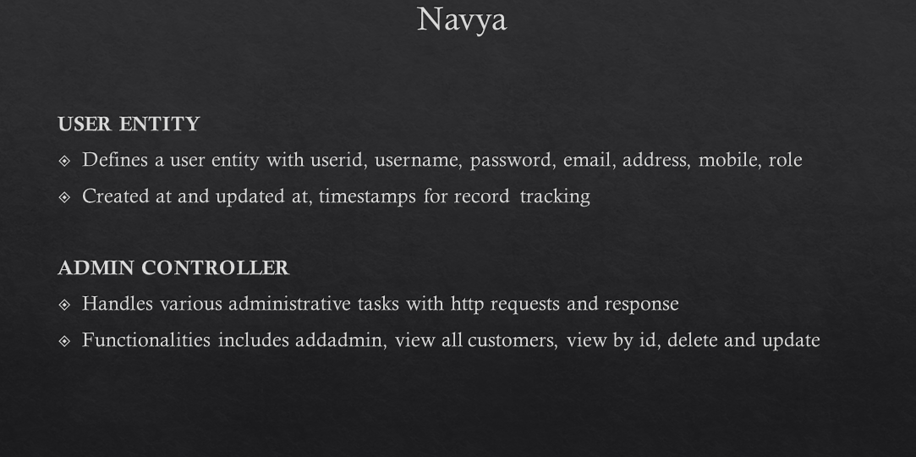

Slide 37
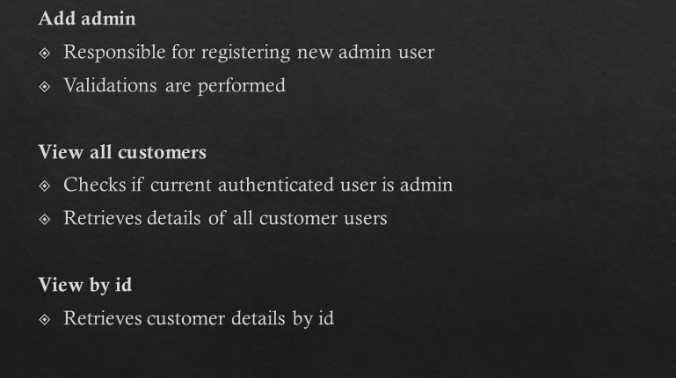

Slide 38
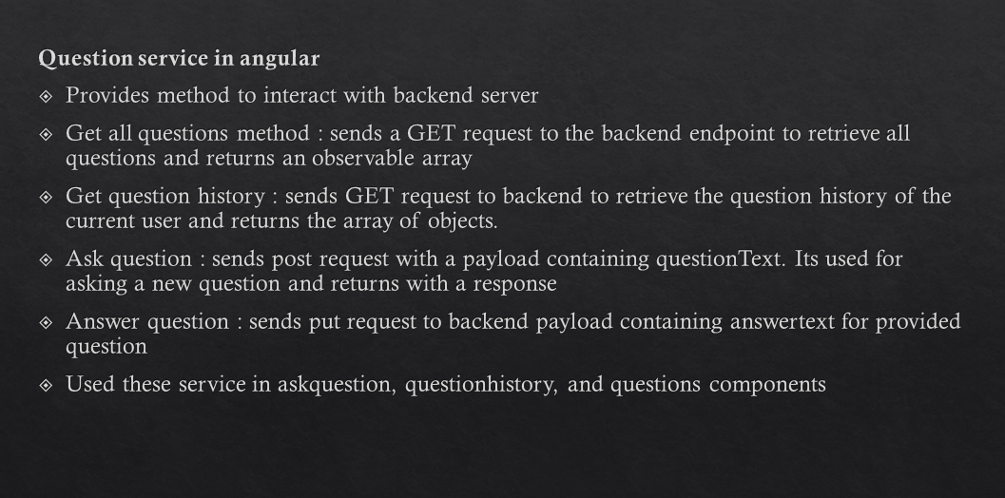

Slide 39
SANDESH
Back end
UPDATE CUSTOMER
ADMIN
UPDATE PROFILE
CUSTOMER
DELETE CUSTOMER
Responsible for creating all of the above server side
functionalities

Slide 40
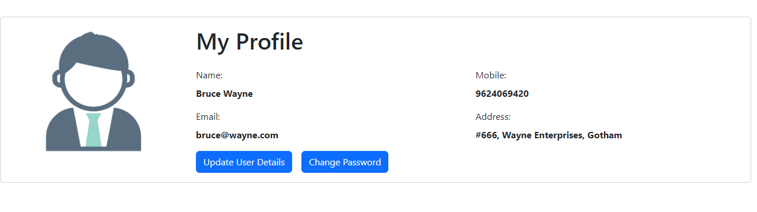
Front end
Profile component
ADMIN
UPDATE PROFILE
CUSTOMER
Responsible for creating the UI and the associated functionalities. ( both back end and front end)

Slide 41
Front end
ADD CATEGORY
DELETE CATEGORY
ADMIN
UPDATE CATEGORY
View All Categories
Responsible for creating all of the above client side
functionalities, including the UI.

Slide 42
Conclusion
Our ClaimSail Application represents a pioneering fusion of technology and insurance. By facilitating seamless policy management and enhancing customer engagement, our project underscores the potential for digital solutions to an otherwise offline industry. With a user-friendly interface and robust backend, our application exemplifies efficiency and innovation.
Thank you for your time.

